Slide 1

Image caption generator
Presented By:
1805113 – K.M Fahim Shahriyar
1805115 – Azizur Rahman Anik

Slide 2
Title : Image Caption Generator Venue : International Journal of Innovative Technology and Exploring Engineering (IJITEE) Published Date : 3rd January 2021 link : https://www.ijitee.org/wp-content/uploads/papers/v10i3/C83830110321.pdf
BASE PAPER INFORMATION
Problem Definition : The System will take an image(2D Array) as input and will generate a text that describes that image in one sentence
Key idea : This paper aims to detect different objects found in an image, recognize the relationships between those objects and generate a caption which describes that image and is syntactically and grammatically correct.

Slide 3
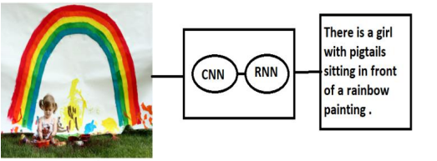
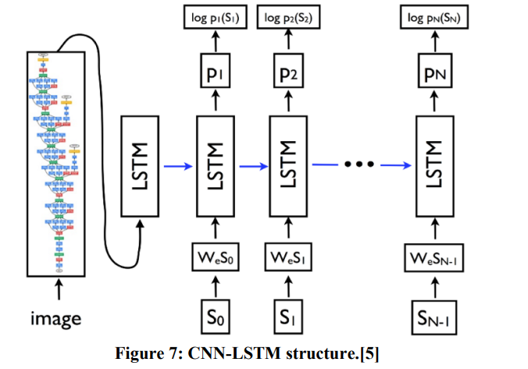
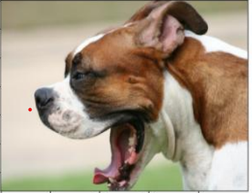
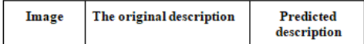
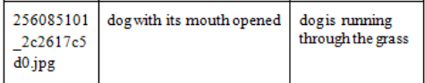
SOLUTION OVERVIEW
KEY RESULTS
256085101_2c2617c5d0.jpg

Slide 4
Code and Data Availability
Image Dataset: https://github.com/jbrownlee/Datasets/releases/download/Flickr8k/Flickr8k_Dataset.zip
Text Dataset: https://github.com/jbrownlee/Datasets/releases/download/Flickr8k/Flickr8k_text.zip
Blog for implementation: https://www.analyticsvidhya.com/blog/2020/11/create-your-own-image-caption-generator-using-keras/

Slide 5
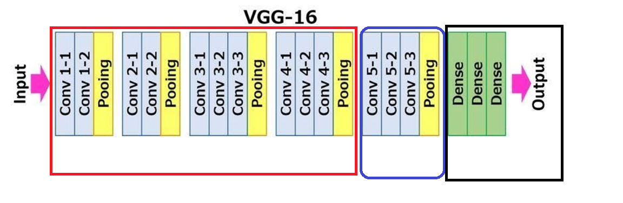
Proposed Experiment
VGG16 pre-trained model to extract features and fine tuning
Freeze this portion for primitive features
Fine Tune
Remove
Data augmentation, weight initialization techniques, dropout, batch-normalization etc to avoid over-fitting and improve accuracy.

Slide 6
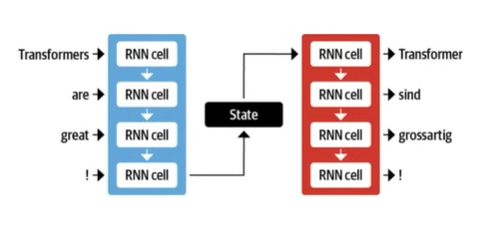
Proposed Experiment
Attention Based Neural Network instead of LSTM in RNN: Transformer
Traditional LSTM uses a single path for short and long term memories.
For longer phrases, even with LSTM, words that are input early on can be forgotten.
Problem of Long Short Term Memory (LSTM)

Slide 7
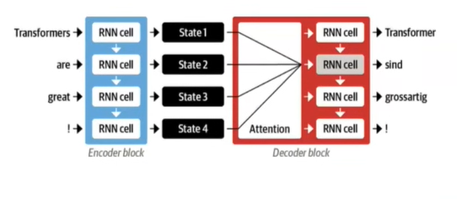
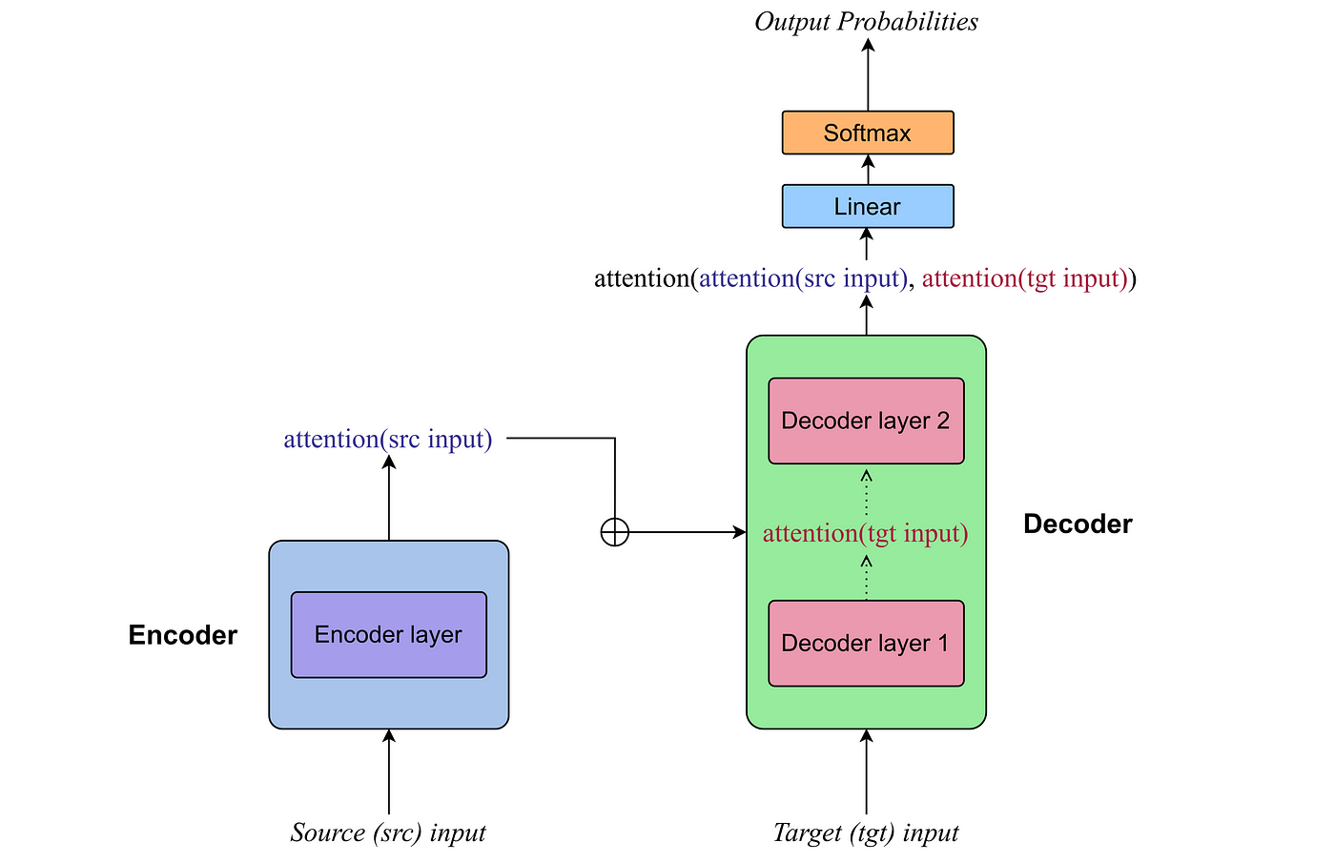
Proposed Experiment
Attention Based Neural Network instead of LSTM in RNN: Transformer
Concept of Attention
Transformer model

Slide 8
Workings of the project

Slide 9
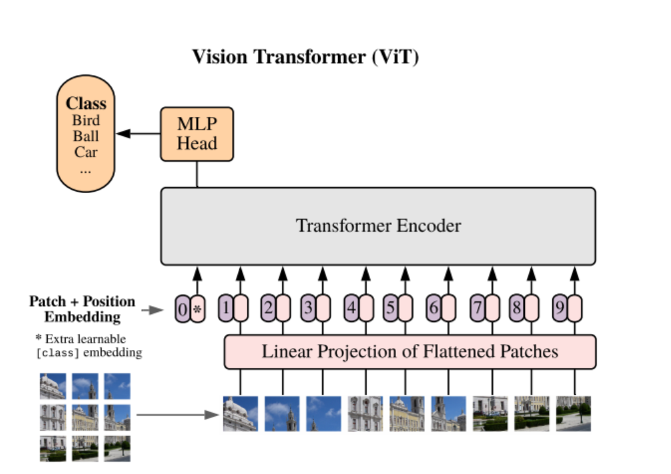
Feature Extraction using ViT

Slide 10
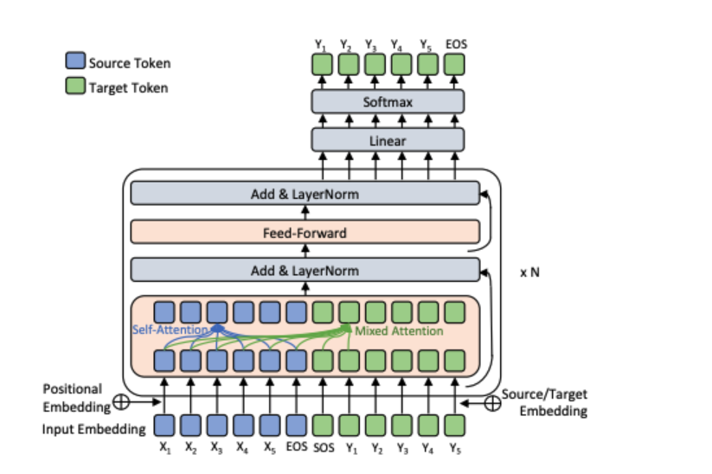
Caption Generator Decoder: GPT-2

Slide 11
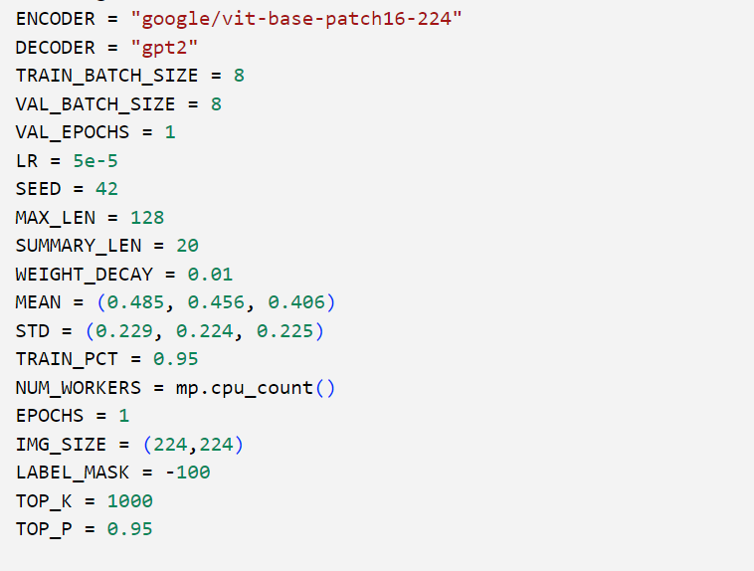
Hyperparameters

Slide 12
Methodology
Input image is read using the Image function of PIL library
Image is transformed using ViT (Vision Transformer)
Transformed image is passed through the feature extractor to extract the pixel values
Captions are tokenized and padded to max length
GPT-2 model is fine tuned to generate captions
BLEU score metric is used to evaluate the quality of the caption

Slide 13
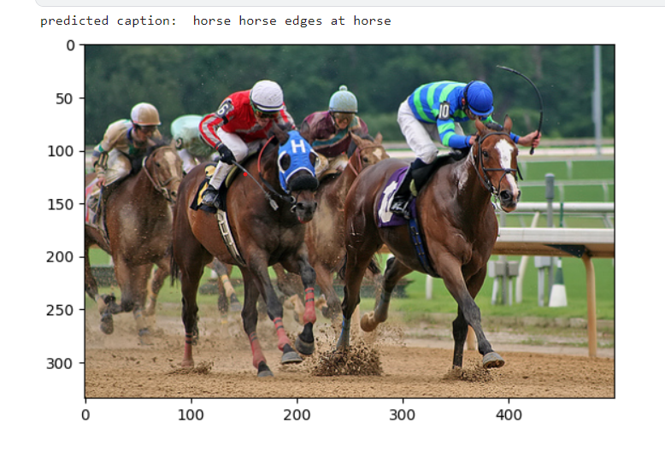
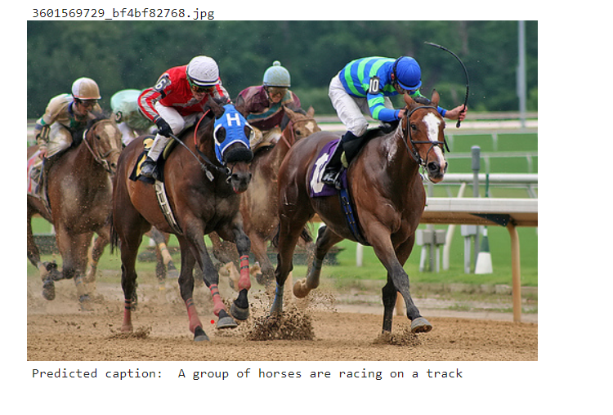
Output Analysis
Base Paper
Our Model

Slide 14
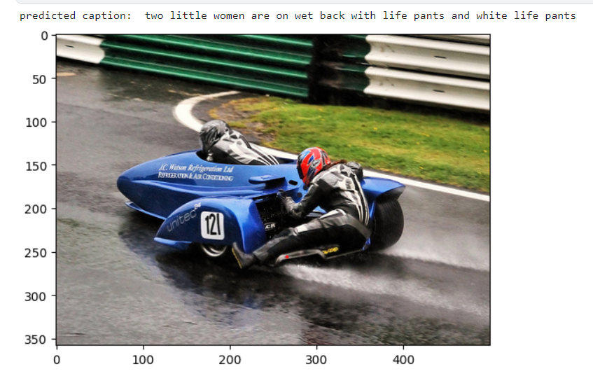
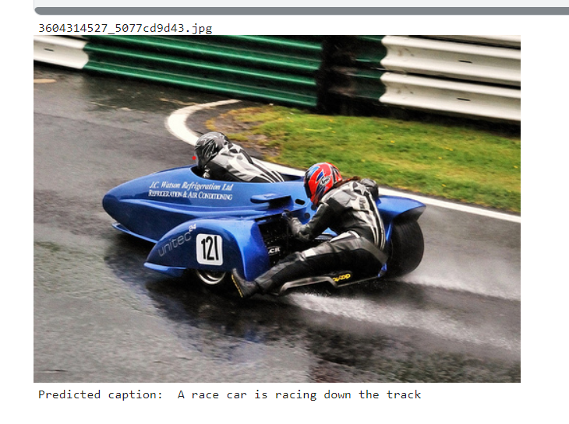
Output Analysis
Base Paper
Our Model

Slide 15
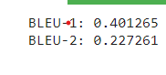
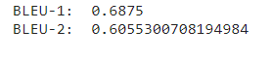
BLEU SCORE
Base Paper
Our Model

Slide 16

Thank you

